Slide 1
Basic Electrical Technology [ELE 1051]
Three Phase AC Circuits
L24 – Power Associated with Three Phase System

Slide 2
Topics Covered
Power in 3 phase system: active, reactive and apparent.
Power measurement

Slide 3











Three Phase Power
1. Star Connected Load
I_{R}
R
Complex Power,
V_{R′O}
Z_{R}
$S=V_{RO}{I_{R}}^{∗}+$ $V_{YO}{I_{Y}}^{∗}+V_{BO}{I_{B}}^{∗}$
V_{RY}
V_{BR}
V_{B′O}
Active Power,
Z_{Y}
O
$$P=V_{RO}{ I}_{R} Cos({{ V}_{RO} \& I}_{R})+$$
I_{Y}
Z_{B}
V_{Y′O}
B
$$V_{YO}{ I}_{Y} Cos({{ V}_{YO} \& I}_{Y})+$$
Y
V_{YB}
I_{B}
$$V_{BO}{ I}_{B} Cos({{ V}_{BO} \& I}_{B})$$
Reactive Power,
For Balanced Load,
$$Q=V_{RO}{ I}_{R} Sin({{ V}_{RO} \& I}_{R})+$$
Complex Power,
$$S=\sqrt{3}{ V}_{L}{{ I}_{L}}_{}^{∗}$$
$$V_{YO}{ I}_{Y} Sin({{ V}_{YO} \& I}_{Y})+$$
Active Power,
$$P={\sqrt{3} V}_{L}{ I}_{L} Cos∠±θ$$
$$V_{BO}{ I}_{B} Sin({{ V}_{BO} \& I}_{B})$$
Reactive Power,
$$Q={\sqrt{3} V}_{L}{ I}_{L} Sin∠±θ$$
Apparent Power,
$$S={\sqrt{3} V}_{L}{ I}_{L}$$

Slide 4








Three Phase Power…
I_{R}
R
2. Delta Connected Load
Complex Power,
I_{R′Y′}
$S=V_{RY}{I_{RY}}^{∗}+$ $V_{YB}{I_{YB}}^{∗}+V_{BR}{I_{BR}}^{∗}$
V_{RY}
Z_{RY}
Z_{BR}
Active Power,
V_{BR}
I_{B′R′}
I_{Y}
$$P=V_{RY}{ I}_{RY} Cos({{ V}_{RY} \& I}_{RY})$$
B
$${+ V}_{YB}{ I}_{YB} Cos({{ V}_{YB} \& I}_{YB})$$
Y
I_{Y′B′}
Z_{YB}
V_{YB}
I_{B}
$$+ V_{BR}{ I}_{BR} Cos({{ V}_{BR} \& I}_{BR})$$
Reactive Power,
For Balanced Load,
$$Q=V_{RY}{ I}_{RY} Sin({{ V}_{RY} \& I}_{RY})$$
Complex Power,
$$S=3{ V}_{ph}{{ I}_{ph}}_{}^{∗}$$
$${+ V}_{YB}{ I}_{YB} Sin({{ V}_{YB} \& I}_{YB})$$
Active Power,
$$P={\sqrt{3} V}_{L}{ I}_{L} Cos∠±θ$$
$${+ V}_{BR}{ I}_{BR} Sin({{ V}_{BR} \& I}_{BR})$$
Reactive Power,
$$Q={\sqrt{3} V}_{L}{ I}_{L} Sin∠±θ$$
Apparent Power,
$$S={\sqrt{3} V}_{L}{ I}_{L}$$

Slide 5
Exercise-1
A balanced star connected load of 8+j6 Ω per phase is connected to a 3 phase, 415V supply. Find the line currents, power factor, power, reactive volt amperes and total volt amperes.

Slide 6
Exercise-2
A star connected load is supplied from a symmetrical three phase, 440V system. The branch impedances of the load are ,Z_{R} = 5∠30° Ω , Z_{Y} = 10∠45° Ω , Z_{B} = 10∠60° Ω . Find the active power supplied by the source.

Slide 7








Measurement of 3 Ph. Active Power
3-Phase Load using 2 Wattmeter
W₁
Wattmeter Reading,
I_{R}
R′
$$W_{1}=v_{RY}{ i}_{R}=(v_{RO}−v_{YO}){ i}_{R}$$
Z_{R}
$$W_{2}=v_{BY}{ i}_{B}=(v_{BO}−v_{YO}){ i}_{B}$$
V_{RY}
O
I_{Y}
Z_{Y}
Z_{B}
Total Active Power,
B′
Y′
$${=W}_{1}+W_{2}$$
V_{BY}
$$={(v}_{RO}−v_{YO}){ i}_{R}+ (v_{BO}−v_{YO}){ i}_{B}$$
I_{B}
W₂
$$=v_{RO}{ i}_{R}−v_{YO}{( i}_{R}+{ i}_{B})+ v_{BO}{ i}_{B}$$
$$=v_{RO}{ i}_{R}+v_{YO}{ i}_{Y}+ v_{BO}{ i}_{B}$$
$$Since, { i}_{R}+{{ i}_{Y}+i}_{B}=0$$

Slide 8
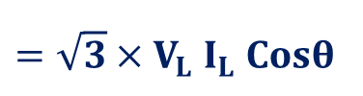






Measurement of 3 Ph. Active Power
3-Phase Load using 2 Wattmeter
Wattmeter Reading,
$$W_{1}=V_{RY}{ I}_{R} Cos({{ V}_{RY} \& I}_{R})$$
V_{BY} = -V_{YB}
$$=V_{L}{ I}_{L} Cos(30°+θ)$$
V_{BR}
V_{BO}
V_{RY}
I_{B}
$$W_{2}=V_{BY}{ I}_{B} Cos({{ V}_{BY} \& I}_{B})$$
$$=V_{L}{ I}_{L} Cos(30°−θ)$$
θ
30°
30°
V_{R0}
Total active power consumed,
I_{Y}
θ
I_{R}
$$P=W_{1}+{ W}_{2}$$
V_{YO}
$$=V_{L}{ I}_{L} Cos\left(30°+θ\right)+V_{L}{ I}_{L} Cos(30°−θ)$$
$$=\sqrt{3}×V_{L}{ I}_{L} Cosθ$$
V_{YB}

Slide 9

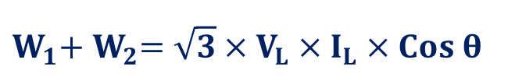


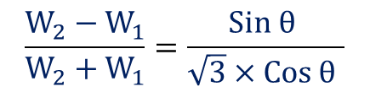

Meas. of 3 Ph. Active Power…
Summation of two wattmeters,
$$W_{1}+{ W}_{2}=\sqrt{3}×V_{L}×I_{L}×Cos θ$$
Difference in the reading of two wattmeters,
$$W_{2}−{ W}_{1}=V_{L}×I_{L}×Sin θ$$
Hence,
$$\frac{W_{2}−{ W}_{1}}{W_{2}+{ W}_{1}}=\frac{Sin θ }{\sqrt{3}×Cos θ }$$
$$tan θ=\left[√3×\frac{W_{2}−W_{1}}{W_{2}+{ W}_{1}}\right]$$
$$tan θ=\left[√3×\frac{Higher Reading−Lower Reading}{Higher Reading+Lower Reading}\right]$$
$$Cosθ=Cos\left\{\tan^{−1}\left[√3×\frac{W_{2}−W_{1}}{W_{2}+{ W}_{1}}\right] \right\}$$
Power factor of the Balanced Load =

Slide 10
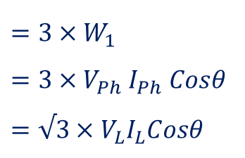


Measurement of 3 Ph. Active Power
3. Balanced Load (Star Connected) using 1 Wattmeter
Wattmeter Reading,
W₁
I_{R}
$$W_{1}=V_{RO}{ I}_{R} Cos({{ V}_{RO} \& I}_{R})$$
R′
$$=V_{Ph}{ I}_{Ph} Cosθ$$
Z_{R}
V_{R′O}
Total active power consumed,
$${=3×W}_{1}$$
$$={3×V}_{Ph}{ I}_{Ph} Cosθ$$
$$=√3×V_{L}I_{L}Cosθ$$
O
I_{Y}
Z_{Y}
Z_{B}
B′
Y′
I_{B}

Slide 11
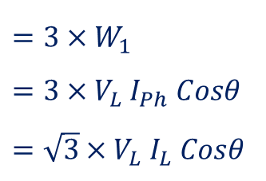


Measurement of 3 Ph. Active Power
4. Balanced Load (Delta Connected) using 1 Wattmeter
Wattmeter Reading,
I_{R}
R′
$$W_{1}=V_{RY}{ I}_{RY} Cos({{ V}_{RY} \& I}_{RY})$$
$$=V_{L}{ I}_{Ph} Cosθ$$
W₁
Z_{BR}
V_{RY}
Total active power consumed,
Z_{RY}
I_{B′R′}
$${=3×W}_{1}$$
$$={3×V}_{L}{ I}_{Ph} Cosθ$$
$$=\sqrt{3}×V_{L}{ I}_{L} Cosθ$$
I_{Y}
I_{R′Y′}
B′
Y′
I_{Y′B′}
Z_{YB}
V_{YB}
I_{B}

Slide 12
Exercise-3
Three identical impedances of (8+j6) Ω are connected in delta across a symmetrical 3 phase, 3 wire 400 V system. Calculate the power factor using wattmeter readings.

Slide 13
Exercise-4
Three loads Z_{R} = 5∠30° Ω , Z_{Y} = 10∠45° Ω , Z_{B} = 10∠60° Ω are connected in Star to R, Y and B Phase respectively. The current coils of the two wattmeters are connected in R & Y lines. If the supply voltage is 415V, 50 Hz, determine the reading of the two wattmeters. Assume the phase sequence is RBY.

Slide 14
Summary
Measurement of Active Power for a three phase Star/Delta connected balanced/unbalanced load can be performed by using two wattmeters.
For a balanced Load, the Load Power factor can be measured by using one or two wattmeter method.
Measurement of power for a balanced Star/Delta load can be performed using one wattmeter.

